Slide 1
Introduction to Sorting

Slide 2
Introduction to sorting
Stacks, queues, priority queues, and dictionaries all focused on providing one element at a time
But often we know we want “all the data items” in some order
A huge reason to use computers: an 8-year-old child can sort, but a computer can sort faster
Different algorithms have different asymptotic and constant-factor trade-offs
Knowing one way to sort just isn’t enough

Slide 3
More reasons to sort
General technique in computing:
Preprocess data to make subsequent operations faster
Example: Sort the data so that you can
Find the k^{th} largest in constant time for any k
Perform binary search to find an element in logarithmic time
Whether the performance of the preprocessing matters depends on
How often the data will change
How much data there is

Slide 4
The main problem, stated carefully
For now we will assume we have n comparable elements in an array and we want to rearrange them to be in increasing order
Input:
An array A of data records
A key value in each data record
A comparison function (consistent and total)
Effect:
Reorganize the elements of A such that for any i and j, if i < j then A[i] ≤ A[j]
(A must have all the same data it started with)
An algorithm doing this is a comparison sort

Slide 5
Variations on the basic problem
Maybe elements are in a linked list (could convert to array and back in linear time, but some algorithms needn’t do so)
Maybe ties need to be resolved by “original array position”
Sorts that do this naturally are called stable sorts
Others could tag each item with its original position and adjust comparisons accordingly (non-trivial constant factors)
Maybe we must not use more than O(1) “auxiliary space”
Sorts meeting this requirement are called in-place sorts
Maybe we can do more with elements than just compare
Sometimes leads to faster algorithms
Maybe we have too much data to fit in memory
Use an “external sorting” algorithm

Slide 6
The Big Picture
Simple
algorithms:
O(n²)
Fancier
algorithms:
O(n log n)
Comparison
lower bound:
Ω(n log n)
Specialized
algorithms:
O(n)
Handling
huge data
sets
Insertion sort
Selection sort
Shell sort
…
Heap sort
Merge sort
Quick sort (avg)
…
Bucket sort
Radix sort
External
sorting
Start with: How would “normal people (?)” sort?

Slide 7
Insertion Sort
Idea: At the k^{th} step put the k^{th} element in the correct place among the first k elements
“Loop invariant”: when loop index is i,first i elements are sorted
Alternate way of saying this:
Sort first two elements
Now insert 3rd element in order
Now insert 4th element in order
…
Time?
Best-case _____ Worst-case _____ “Average” case ____

Slide 8
Insertion Sort
Idea: At the k^{th} step put the k^{th} element in the correct place among the first k elements
“Loop invariant”: when loop index is i,first i-1 elements are sorted
Alternate way of saying this:
Sort first two elements
Now insert 3rd element in order
Now insert 4th element in order
…
Time?
Best-case O(n) Worst-case O(n²) “Average” case O(n²)
start sorted start reverse sorted

Slide 9
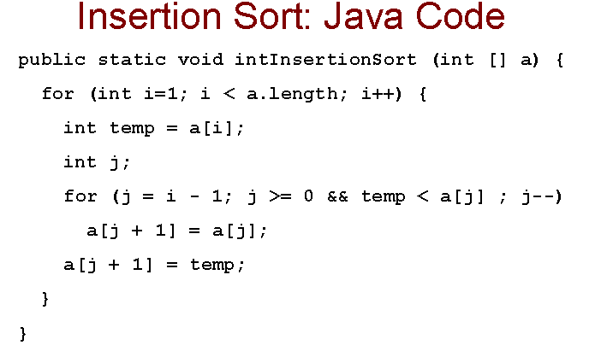
If a is sorted, n – 1 data comparisons are used. In the worst case, n(n-1)/2 are used

Slide 10
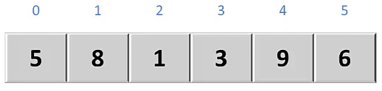
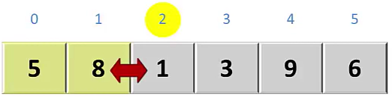
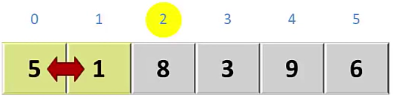
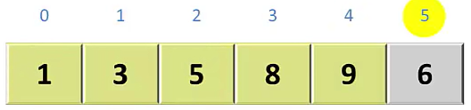
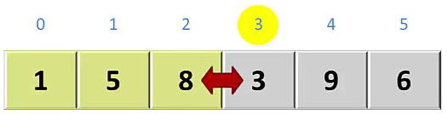
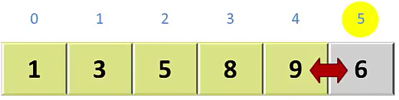
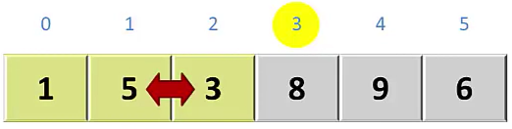
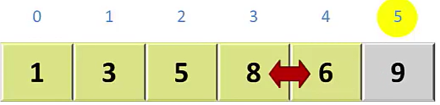
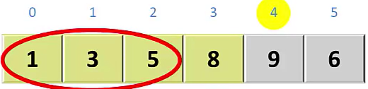

Slide 11
Selection sort
Idea: At the k^{th} step, find the smallest element among the not-yet-sorted elements and put it at position k
“Loop invariant”: when loop index is i,first i elements are the i smallest elements in sorted order
Alternate way of saying this:
Find smallest element, put it 1st
Find next smallest element, put it 2nd
Find next smallest element, put it 3rd
…
Time?
Best-case _____ Worst-case _____ “Average” case ____

Slide 12
Selection sort
Idea: At the k^{th} step, find the smallest element among the not-yet-sorted elements and put it at position k
“Loop invariant”: when loop index is i,first i-1 elements are the i-1 smallest elements in sorted order
Alternate way of saying this:
Find smallest element, put it 1st
Find next smallest element, put it 2nd
Find next smallest element, put it 3rd
…
Time?
Best-case O(n²) Worst-case O(n²) “Average” case O(n²)
Always T(1) = 1 and T(n) = n + T(n-1)

Slide 13
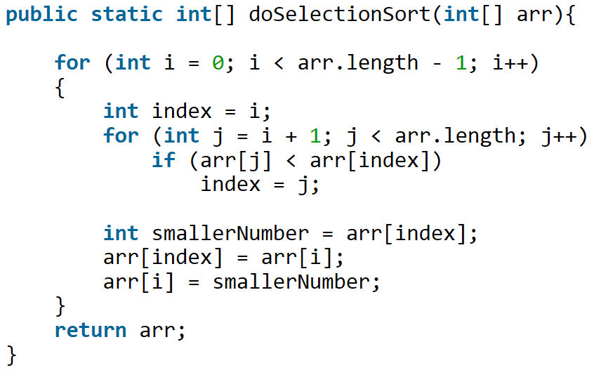
n(n-1)/2 comparisons Selection Sort: Java Code

Slide 14


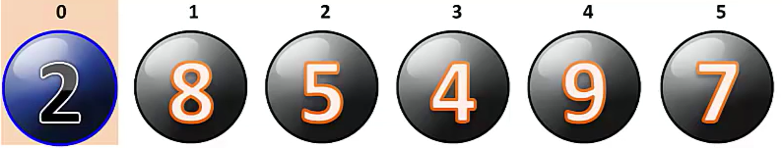
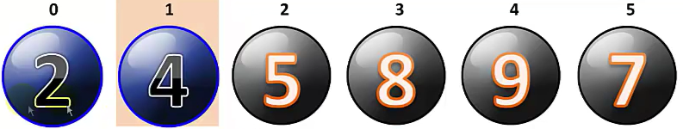
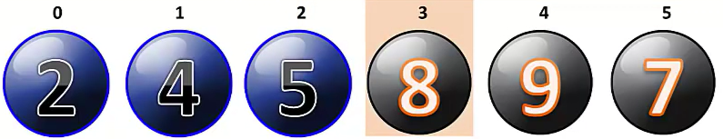
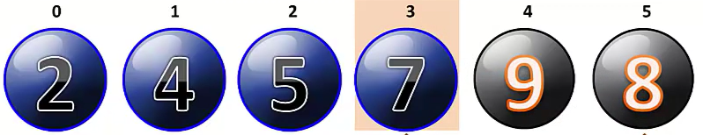
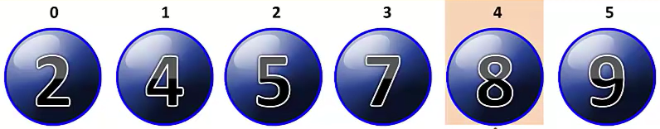

Slide 15
Insertion vs. Selection
They are different algorithms
They solve the same problem
They have the same worst-case and average-case asymptotic complexity
Insertion-sort has better best-case complexity; preferable when input is “mostly sorted”
Other algorithms are more efficient for non-small arrays that are not already almost sorted

Slide 16
Shell sort is a sorting algorithm that requires asymptotically fewer than O(n²) comparisons and exchanges in the worst case. Although it is easy to develop an intuitive sense of how this algorithm works, it is very difficult to analyze its execution time, but estimates range from O(nlog₂ n) to O(n^{1.5}) depending on implementation details.

Slide 17
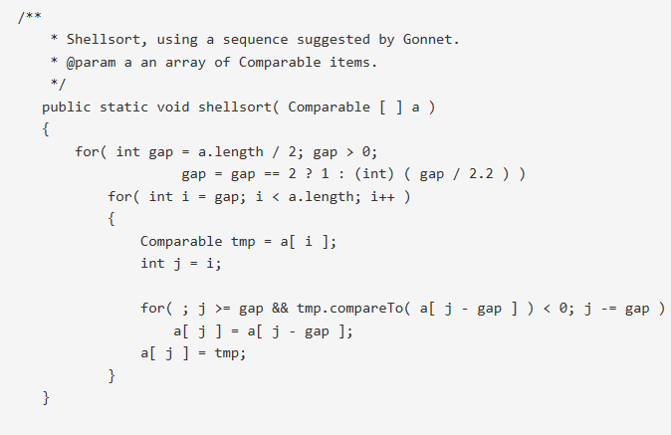
Shell Sort: Java Code

Slide 18
The Big Picture
Surprising amount of juicy computer science: 2-3 lectures…
Simple
algorithms:
O(n²)
Fancier
algorithms:
O(n log n)
Comparison
lower bound:
Ω(n log n)
Specialized
algorithms:
O(n)
Handling
huge data
sets
Insertion sort
Selection sort
Shell sort
…
Heap sort
Merge sort
Quick sort (avg)
…
Bucket sort
Radix sort
External
sorting

Slide 19
Heap sort
sorting with a heap is easy:
insert each arr[i], better yet buildHeap
for(i=0; i < arr.length; i++)
arr[i] = deleteMin();
Worst-case running time: O(n log n)
We have the array-to-sort and the heap
So this is not an in-place sort
There’s a trick to make it in-place…

Slide 20
In-place heap sort
But this reverse sorts –
how would you fix that?
Treat the initial array as a heap (via buildHeap)
When you delete the i^{th} element, put it at arr[n-i]
It’s not part of the heap anymore!
4
7
5
9
8
6
10
3
2
1
heap part
sorted part
5
7
6
9
8
10
4
3
2
1
arr[n-i]=
deleteMin()
heap part
sorted part

Slide 21
“AVL sort”
We can also use a balanced tree to:
insert each element: total time O(n log n)
Repeatedly deleteMin: total time O(n log n)
But this cannot be made in-place and has worse constant factors than heap sort
heap sort is better
both are O(n log n) in worst, best, and average case
neither parallelizes well
Don’t even think about trying to sort with a hash table

Slide 22
Divide and conquer
Very important technique in algorithm design
Divide problem into smaller parts
Solve the parts independently
Think recursion
Or potential parallelism
Combine solution of parts to produce overall solution
(The name “divide and conquer” is rather clever.)

Slide 23
Divide-and-conquer sorting
Two great sorting methods are fundamentally divide-and-conquer
Mergesort: Sort the left half of the elements (recursion)
Sort the right half of the elements (recursion)
Merge the two sorted halves into a sorted whole
Quicksort: Pick a “pivot” element
Divide elements into less-than pivot
and greater-than pivot
Sort the two divisions (recursion twice)
Answer is sorted-less-than then pivot then
sorted-greater-than

Slide 24
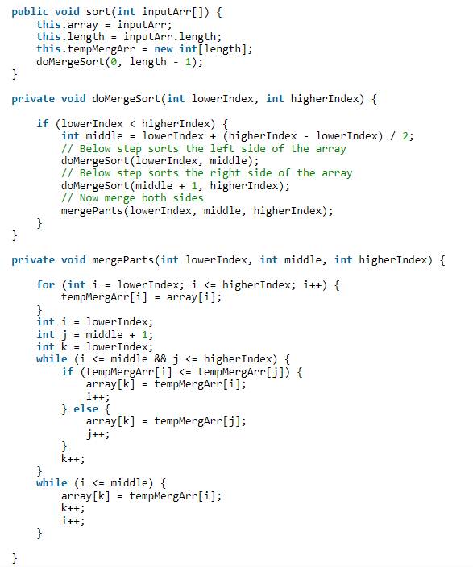
Merge Sort

Slide 25
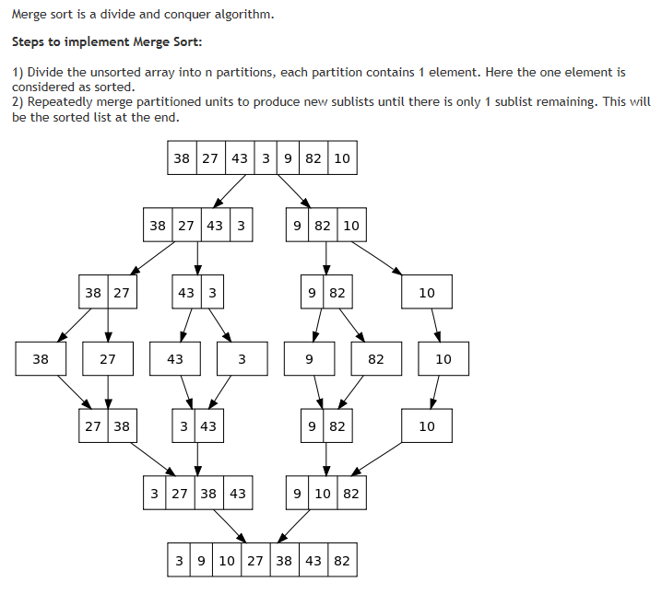
Merge Sort

Slide 26
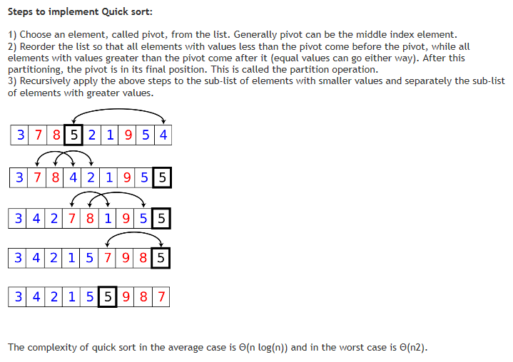
Quick Sort

Slide 27
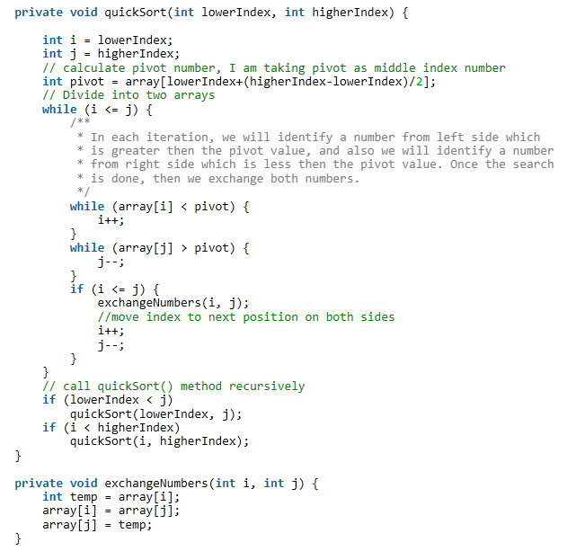
Quick Sort

Slide 28
Mergesort
8
2
9
4
5
3
1
6
To sort array from position lo to position hi:
If range is 1 element long, it’s sorted! (Base case)
Else:
Sort from lo to (hi+lo)/2
Sort from (hi+lo)/2 to hi
Merge the two halves together
Merging takes two sorted parts and sorts everything
O(n) but requires auxiliary space…

Slide 29
Example, focus on merging
Start with:
8
2
9
4
5
3
1
6
After recursion:
(not magic ☺)
2
4
8
9
1
3
5
6
Merge:
Use 3 “fingers”
and 1 more array
(After merge, copy back to original array)

Slide 30
Example, focus on merging
Start with:
8
2
9
4
5
3
1
6
After recursion:
(not magic ☺)
2
4
8
9
1
3
5
6
Merge:
Use 3 “fingers”
and 1 more array
1
(After merge, copy back to original array)

Slide 31
Example, focus on merging
Start with:
8
2
9
4
5
3
1
6
After recursion:
(not magic ☺)
2
4
8
9
1
3
5
6
Merge:
Use 3 “fingers”
and 1 more array
1
2
(After merge, copy back to original array)

Slide 32
Example, focus on merging
Start with:
8
2
9
4
5
3
1
6
After recursion:
(not magic ☺)
2
4
8
9
1
3
5
6
Merge:
Use 3 “fingers”
and 1 more array
1
2
3
(After merge, copy back to original array)

Slide 33
Example, focus on merging
Start with:
8
2
9
4
5
3
1
6
After recursion:
(not magic ☺)
2
4
8
9
1
3
5
6
Merge:
Use 3 “fingers”
and 1 more array
1
2
3
4
(After merge, copy back to original array)

Slide 34
Example, focus on merging
Start with:
8
2
9
4
5
3
1
6
After recursion:
(not magic ☺)
2
4
8
9
1
3
5
6
Merge:
Use 3 “fingers”
and 1 more array
1
2
3
4
5
(After merge, copy back to original array)

Slide 35
Example, focus on merging
Start with:
8
2
9
4
5
3
1
6
After recursion:
(not magic ☺)
2
4
8
9
1
3
5
6
Merge:
Use 3 “fingers”
and 1 more array
1
2
3
4
5
6
(After merge, copy back to original array)

Slide 36
Example, focus on merging
Start with:
8
2
9
4
5
3
1
6
After recursion:
(not magic ☺)
2
4
8
9
1
3
5
6
Merge:
Use 3 “fingers”
and 1 more array
1
2
3
4
5
6
8
(After merge, copy back to original array)

Slide 37
Example, focus on merging
Start with:
8
2
9
4
5
3
1
6
After recursion:
(not magic ☺)
2
4
8
9
1
3
5
6
Merge:
Use 3 “fingers”
and 1 more array
1
2
3
4
5
6
8
9
(After merge, copy back to original array)

Slide 38
Example, focus on merging
Start with:
8
2
9
4
5
3
1
6
After recursion:
(not magic ☺)
2
4
8
9
1
3
5
6
Merge:
Use 3 “fingers”
and 1 more array
1
2
3
4
5
6
8
9
(After merge, copy back to original array)
1
2
3
4
5
6
8
9

Slide 39
Example, showing recursion
8
2
9
4
5
3
1
6
Divide
8 2 9 4
5 3 1 6
Divide
8 2
9 4
5 3
1 6
Divide
1 element
8 2
9 4
5 3
1 6
Merge
2 8
4 9
3 5
1 6
Merge
2 4 8 9
1 3 5 6
Merge
1 2 3 4 5 6 8 9

Slide 40
Some details: saving a little time
In our example, we copied the “dregs” into the auxiliary array, but that’s unnecessary right before copying back
If left-side finishes first, just stop the merge:
If right-side finishes first, copy dregs directly into right side
copy
first
second

Slide 41
Some details: saving space / copying
Simplest / worst approach:
Use a new auxiliary array of size (hi-lo) for every merge
Better:
Use a new auxiliary array of size n for every merging stage
Better:
Reuse same auxiliary array of size n for every merging stage
Best (but a little tricky):
Don’t copy back – at 2nd, 4th, 6th, … merging stages, use the original array as the auxiliary array and vice-versa
Need one copy at end if number of stages is odd

Slide 42
Picture of the “best”
Arguably easier to code up without recursion at all
Merge by 1
Merge by 2
Merge by 4
Merge by 8
Merge by 16
Copy if Needed

Slide 43
Linked lists and big data
We defined the sorting problem as over an array, but sometimes you want to sort linked lists
One approach:
Convert to array: O(n)
Sort: O(n log n)
Convert back to list: O(n)
Or: mergesort works very nicely on linked lists directly
heapsort and quicksort do not
insertion sort and selection sort do but they’re slower
Mergesort is also the sort of choice for external sorting
Linear merges minimize disk accesses

Slide 44
Analysis
Having defined an algorithm and argued it is correct, we should analyze its running time (and space):
To sort n elements, we:
Return immediately if n=1
Else do 2 subproblems of size n/2 and then an O(n) merge
Recurrence relation:
T(1) = c₁
T(n) = 2T(n/2) + c₂n

Slide 45
One of the recurrence classics…
(For simplicity let constants be 1 – no effect on asymptotic answer)
T(1) = 1 So total is 2^{k}T(n/2^{k}) + kn where
T(n) = 2T(n/2) + n n/2^{k} = 1, i.e., log n = k
= 2(2T(n/4) + n/2) + n That is, 2^{log n} T(1) + n log n
= 4T(n/4) + 2n = n + n log n
= 4(2T(n/8) + n/4) + 2n = O(n log n)
= 8T(n/8) + 3n
….
= 2^{k}T(n/2^{k}) + kn

Slide 46
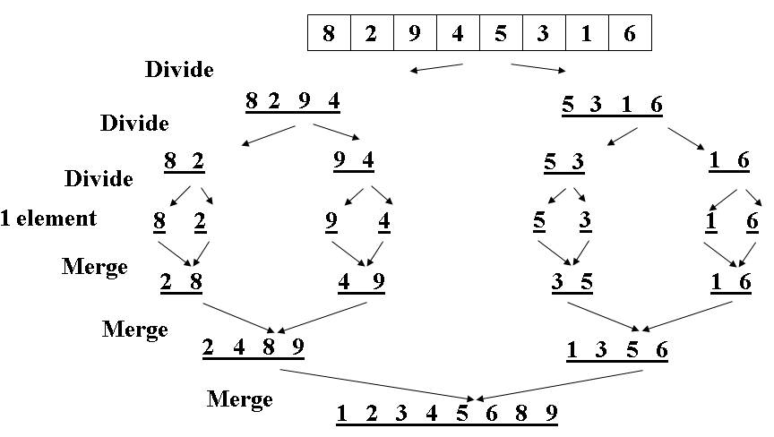
Or more intuitively…
This recurrence comes up often enough you should just “know” it’s O(n log n)
Merge sort is relatively easy to intuit (best, worst, and average):
The recursion “tree” will have log n height
At each level we do a total amount of merging equal to n

Slide 47
Quicksort
Also uses divide-and-conquer
Does not need auxiliary space
O(n log n) on average, but O(n²) worst-case
Faster than mergesort in practice?
Often believed so
Does fewer copies and more comparisons, so it depends on the relative cost of these two operations!
But we’re getting ahead of ourselves, how does it work…

Slide 48
Quicksort overview
Pick a pivot element
Partition all the data into:
The elements less than the pivot
The pivot
The elements greater than the pivot
Recursively sort A and C
The answer is, “as simple as A, B, C”
(Alas, there are some details lurking in this algorithm)

Slide 49
Think in terms of sets
S
select pivot value
81
43
31
57
13
75
92
0
65
26
S₁
S₂
partition S
0
31
75
13
43
65
92
81
26
57
S₁
S₂
QuickSort(S₁) and
QuickSort(S₂)
0
13
26
31
43
57
65
75
81
92
S
0
13
26
31
43
57
65
75
81
92
Presto! S is sorted
[Weiss]

Slide 50
Example, showing recursion
8
2
9
4
5
3
1
6
Divide
5
2 4 3 1
8 9 6
Divide
3
2 1
4
6
8
9
Divide
1 element
1
2
Conquer
1 2
Conquer
1 2 3 4
6 8 9
Conquer
1 2 3 4 5 6 8 9

Slide 51
Details
We haven’t explained:
How to pick the pivot element
Any choice is correct: data will end up sorted
But as analysis will show, want the two partitions to be about equal in size
How to implement partitioning
In linear time
In place

Slide 52
Potential pivot rules
While sorting arr from lo (inclusive) to hi (exclusive)…
Pick arr[lo] or arr[hi-1]
Fast, but worst-case is (mostly) sorted input
Pick random element in the range
Does as well as any technique, but (pseudo)random number generation can be slow
(Still probably the most elegant approach)
Median of 3, e.g., arr[lo], arr[hi-1], arr[(hi+lo)/2]
Common heuristic that tends to work well

Slide 53
Partitioning
Conceptually simple, but hardest part to code up correctly
After picking pivot, need to partition in linear time in place
One approach (there are slightly fancier ones):
Swap pivot with arr[lo]
Use two fingers i and j, starting at lo+1 and hi-1
while (i < j)
if (arr[j] > pivot) j--
else if (arr[i] < pivot) i++
else swap arr[i] with arr[j]
Swap pivot with arr[i]

Slide 54
Example
Step one: pick pivot as median of 3
lo = 0, hi = 10
0
1
2
3
4
5
6
7
8
9
8
1
4
9
0
3
5
2
7
6
Step two: move pivot to the lo position
0
1
2
3
4
5
6
7
8
9
6
1
4
9
0
3
5
2
7
8

Slide 55
Example
Often have more than
one swap during partition –
this is a short example
Now partition in place
Move fingers
Swap
Move fingers
Move pivot
6
1
4
9
0
3
5
2
7
8
6
1
4
9
0
3
5
2
7
8
6
1
4
2
0
3
5
9
7
8
6
1
4
2
0
3
5
9
7
8
5
1
4
2
0
3
6
9
7
8

Slide 56
Analysis
Best-case: Pivot is always the median
T(0)=T(1)=1
T(n)=2T(n/2) + n -- linear-time partition
Same recurrence as mergesort: O(n log n)
Worst-case: Pivot is always smallest or largest element
T(0)=T(1)=1
T(n) = 1T(n-1) + n
Basically same recurrence as selection sort: O(n²)
Average-case (e.g., with random pivot)
O(n log n), not responsible for proof (in text)

Slide 57
Cutoffs
For small n, all that recursion tends to cost more than doing a quadratic sort
Remember asymptotic complexity is for large n
Common engineering technique: switch to a different algorithm for subproblems below a cutoff
Reasonable rule of thumb: use insertion sort for n < 10
Notes:
Could also use a cutoff for merge sort
Cutoffs are also the norm with parallel algorithms
switch to sequential
None of this affects asymptotic complexity

Slide 58
Cutoff skeleton
void quicksort(int[] arr, int lo, int hi) {
if(hi – lo < CUTOFF)
insertionSort(arr,lo,hi);
else
…
}
Notice how this cuts out the vast majority of the recursive calls
Think of the recursive calls to quicksort as a tree
Trims out the bottom layers of the tree

Slide 59
The Big Picture
Surprising amount of juicy computer science: 2-3 lectures…
Simple
algorithms:
O(n²)
Fancier
algorithms:
O(n log n)
Comparison
lower bound:
Ω(n log n)
Specialized
algorithms:
O(n)
Handling
huge data
sets
Insertion sort
Selection sort
Shell sort
…
Heap sort
Merge sort
Quick sort (avg)
…
Bucket sort
Radix sort
External
sorting

Slide 60
How fast can we sort?
Heapsort & mergesort have O(n log n) worst-case running time
Quicksort has O(n log n) average-case running times
These bounds are all tight, actually Θ(n log n)
So maybe we need to dream up another algorithm with a lower asymptotic complexity, such as O(n) or O(n log log n)
Instead: prove that this is impossible
Assuming our comparison model: The only operation an algorithm can perform on data items is a 2-element comparison

Slide 61
Permutations
Assume we have n elements to sort
And for simplicity, none are equal (no duplicates)
How many permutations (possible orderings) of the elements?
Example, n=3
a[0]<a[1]<a[2] a[0]<a[2]<a[1] a[1]<a[0]<a[2]
a[1]<a[2]<a[0] a[2]<a[0]<a[1] a[2]<a[1]<a[0]
In general, n choices for least element, then n-1 for next, then n-2 for next, …
n(n-1)(n-2)…(2)(1) = n! possible orderings

Slide 62
Describing every comparison sort
So every sorting algorithm has to “find” the right answer among the n! possible answers
Starts “knowing nothing” and gains information with each comparison
Intuition: At best, each comparison can eliminate half of the remaining possibilities
Can represent this process as a decision tree
Nodes are “remaining possibilities”
Edges are “answers from a comparison”
This is not a data structure, it’s what our proof uses to represent “the most any algorithm could know”

Slide 63
Decision tree for n=3
a < b < c, b < c < a,
a < c < b, c < a < b,
b < a < c, c < b < a
a < b
a ? b
a > b
a < b < c
a < c < b
c < a < b
b < a < c
b < c < a
c < b < a
a < c
a > c
b < c
b > c
a < b < c
a < c < b
c < a < b
b < a < c
b < c < a
c < b < a
b < c
b > c
c < a
c > a
a < b < c
a < c < b
b < c < a
b < a < c
The leaves contain all the possible orderings of a, b, c

Slide 64
What the decision tree tells us
A binary tree because each comparison has 2 outcomes
No duplicate elements
Assume algorithm not so dumb as to ask redundant questions
Because any data is possible, any algorithm needs to ask enough questions to produce all n! answers
Each answer is a leaf (no more questions to ask)
So the tree must be big enough to have n! leaves
Running any algorithm on any input will at best correspond to one root-to-leaf path in the decision tree
So no algorithm can have worst-case running time better than the height of the decision tree

Slide 65
Example
possible orders
a < b < c, b < c < a,
a < c < b, c < a < b,
b < a < c, c < b < a
a < b
a ? b
a > b
a < b < c
a < c < b
c < a < b
b < a < c
b < c < a
c < b < a
a < c
a > c
b < c
b > c
a < b < c
a < c < b
c < a < b
b < a < c
b < c < a
c < b < a
b < c
b > c
c < a
c > a
a < b < c
a < c < b
b < c < a
b < a < c
actual order

Slide 66
Where are we
Proven: No comparison sort can have worst-case running time better than the height of a binary tree with n! leaves
Turns out average-case is same asymptotically
Now: a binary tree with n! leaves has height Ω(n log n)
Factorial function grows very quickly
Conclusion: (Comparison) Sorting is Ω (n log n)
This is an amazing computer-science result: proves all the clever programming in the world can’t sort in linear time

Slide 67
Lower bound on height
The height of a binary tree with L leaves is at least log₂ L
So the height of our decision tree, h:
h ≥ log₂ (n!) property of binary trees
= log₂ (n*(n-1)*(n-2)…(2)(1)) definition of factorial
= log₂ n + log₂ (n-1) + … + log₂ 1 property of logarithms
≥ log₂ n + log₂ (n-1) + … + log₂ (n/2) drop smaller terms (≥0)
≥ (n/2) log₂ (n/2) each of the n/2 terms left is ≥ log₂ (n/2)
= (n/2)(log₂ n - log₂ 2) property of logarithms
= (1/2)nlog₂ n – (1/2)n arithmetic
“=“ Ω (n log n)

Slide 68
The Big Picture
Surprising amount of juicy computer science: 2-3 lectures…
Simple
algorithms:
O(n²)
Fancier
algorithms:
O(n log n)
Comparison
lower bound:
Ω(n log n)
Specialized
algorithms:
O(n)
Handling
huge data
sets
Insertion sort
Selection sort
Shell sort
…
Heap sort
Merge sort
Quick sort (avg)
…
Bucket sort
Radix sort
External
sorting
huh???
Change the model – assume
more than items can be
compared!

Slide 69
BucketSort (a.k.a. BinSort)
If all values to be sorted are known to be integers between 1 and K (or any small range), create an array of size K and put each element in its proper bucket (a.ka. bin)
If data is only integers, don’t even need to store anything more than a count of how times that bucket has been used
Output result via linear pass through array of buckets
count array
1 | 3
2 | 1
3 | 2
4 | 2
5 | 3
Example:
K=5
input (5,1,3,4,3,2,1,1,5,4,5)
output: 1,1,1,2,3,3,4,4,5,5,5

Slide 70
Analyzing bucket sort
Good when range, K, is smaller (or not much larger) than number of elements, n
Don’t spend time doing lots of comparisons of duplicates!
Bad when K is much larger than n
Wasted space; wasted time during final linear O(K) pass
Overall: O(n+K)
Linear in n, but also linear in K
Ω(n log n) lower bound does not apply because this is not a comparison sort
For data in addition to integer keys, use list at each bucket

Slide 71
Radix sort
Radix = “the base of a number system”
Examples will use 10 because we are used to that
In implementations use larger numbers
For example, for ASCII strings, might use 128
Idea:
Bucket sort on one digit at a time
Number of buckets = radix
Starting with least significant digit
Keeping sort stable
After k passes (digits), the last k digits are sorted
Aside: Origins go back to the 1890 U.S. census

Slide 72
Example
Radix = 10
Input: 478
537
9
721
3
38
143
67
0
1
2
3
4
5
6
7
8
9
721
3
143
537
67
478
38
9
Order now: 721
3
143
537
67
478
38
9
First pass:
bucket sort by ones digit

Slide 73
Example
0
1
2
3
4
5
6
7
8
9
721
3
143
537
67
478
38
9
Radix = 10
0
1
2
3
4
5
6
7
8
9
3
9
721
537
38
143
67
478
Order was: 721
3
143
537
67
478
38
9
Second pass:
stable bucket sort by tens digit
Order now: 3
9
721
537
38
143
67
478

Slide 74
Example
0
1
2
3
4
5
6
7
8
9
3
9
721
537
38
143
67
478
Radix = 10
0
1
2
3
4
5
6
7
8
9
3
9
38
67
143
478
537
721
Order was: 3
9
721
537
38
143
67
478
Order now: 3
9
38
67
143
478
537
721
Third pass:
stable bucket sort by 100s digit

Slide 75
Analysis
Input size: n
Number of buckets = Radix: B
Number of passes = “Digits”: P
Work per pass is 1 bucket sort: O(B+n)
Total work is O(P(B+n))
Compared to comparison sorts, sometimes a win, but often not
Example: Strings of English letters up to length 15
15*(52 + n)
This is less than n log n only if n > 33,000
Of course, cross-over point depends on constant factors of the implementations plus P and B
And radix sort can have poor locality properties

Slide 76
Last word on sorting
Simple O(n²) sorts can be fastest for small n
selection sort, insertion sort (latter linear for mostly-sorted)
good for “below a cut-off” to help divide-and-conquer sorts
O(n log n) sorts
heap sort, in-place but not stable nor parallelizable
merge sort, not in place but stable and works as external sort
quick sort, in place but not stable and O(n²) in worst-case
often fastest, but depends on costs of comparisons/copies
Ω (n log n) is worst-case and average lower-bound for sorting by comparisons
Non-comparison sorts
Bucket sort good for small number of key values
Radix sort uses fewer buckets and more phases
Best way to sort? It depends!

